Slide 1
Information Technology Fundamentals
DT228/1
Tutorial 10 – IT Domains
Thursday 1 December 2016

Slide 2
Domains
There are MANY Information Technology Domains:
Business
Science
Education
Healthcare
Telecommunications
Banking
Security
… etc
Answers.com

Slide 3
Disciplines versus Domains
You could view Disciplines WITHIN Domains, or OVERLAPPING Domains:
Domain
Domain
Discipline
Discipline

Slide 4
Into the Domains
Where you ‘find yourself’ in an IT domain depends on certain things…
The PURPOSE of the information technology system,
The MEANS of the IT system (Structure, Infrastructure, Data Types, Usage)
… and your own PERSPECTIVE

Slide 5

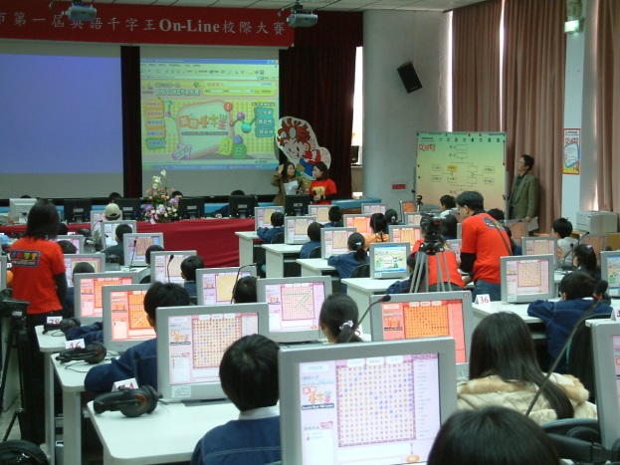
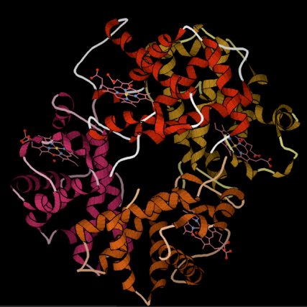
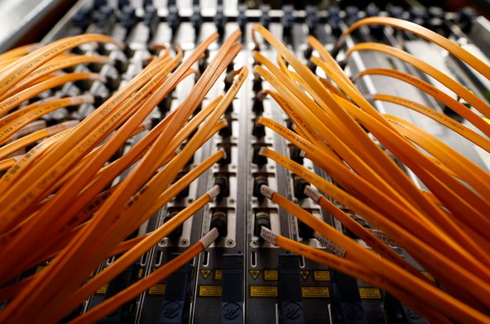
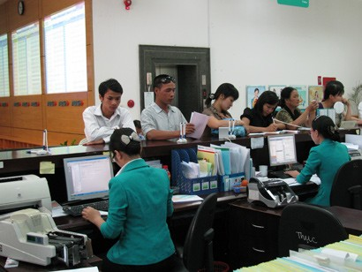


Looking at Domains
Business
Science
Education
Banking
Security
Healthcare
Telecommunications

